Slide 1
Functions and the Call Stack

Slide 2
Call Stack
How does Python keep track of where control needs to go when you call functions?
We already know that python always remembers the point in the program where control currently is.
But that’s not enough, if control is inside a function, Python has to remember the point where the function was called, so control can go back there.
And if the function was called inside another function, Python has to remember where that function was called from, and so forth.
It does this with the help of a special data structure called an execution stack, or call stack.
Think about the execution like a stack of plates, one on top of another. Each plate remember one place in the program where we are executing statements.
In Main at line 25
In geometric _mean at line 12

Slide 3
Call Stack
When you start a program, there’s only one stack frame – the one that tells us where we’re executing the main script.
Let’s say that we call a function, like sqrt.
This pushes a new frame onto the stack, that remembers where we are executing inside the sqrt function.
When we hit the return statement, this pops the last frame off the stack.
The frame underneath tells us where we called sqrt from, so control returns there.
In Main at line 25
In geometric _mean at line 12
Enter
sqrt
Leave
sqrt
In sqrt at line 8

Slide 4
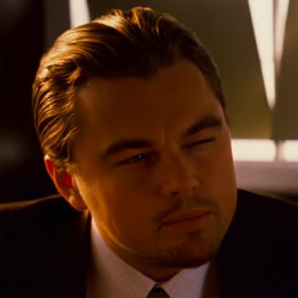
Hint
These stack frames might remind you of separate programs, running side by side.
In fact, as we’ll see, this is a good comparison. A function is very much like a separate program within a program
this will be a useful hint to keep in mind as we keep learning about how they work.
(Within a program…)

